Slide 1
Decision making instructions Session 8

Slide 2
Decision Making
The best part of a computer (i.e. Processor) is the ability towards making decisions. A calculator may not be that intelligent as a computer, from this particular aspect. N
When the input data changes dynamically during runtime, there is a certain need to pull out different set of instructions. (if A, Call X. if B, Call Y)
We are familiar with this in our high level programming languages through if, if else, while, do while etc. History has used goto as an option as well, which slowly has disappeared in the modern programming world.
MIPS is supporting 2 such instructions BEQ and BNE.

Slide 3
Contd.,
The first instruction to be learnt is “BEQ” which can be expanded as Branch if Equal.
BEQ Reg1, Reg2, Label
What does this instruction imply? Simple. It says that the value in the reg1 shall be compared with value in reg2. if found equal, the branching shall happen to the label.
The second instruction is “BNE” which gets expanded as Branch if Not Equal.
BNE Reg1, Reg2, Label
It means go to the statement labeled L1 if the value in register1 does not equal the value in register2.
The mnemonic bne stands for branch if not equal.
These two instructions are traditionally called conditional branches
Slt is homework. Try it out yourself.

Slide 4
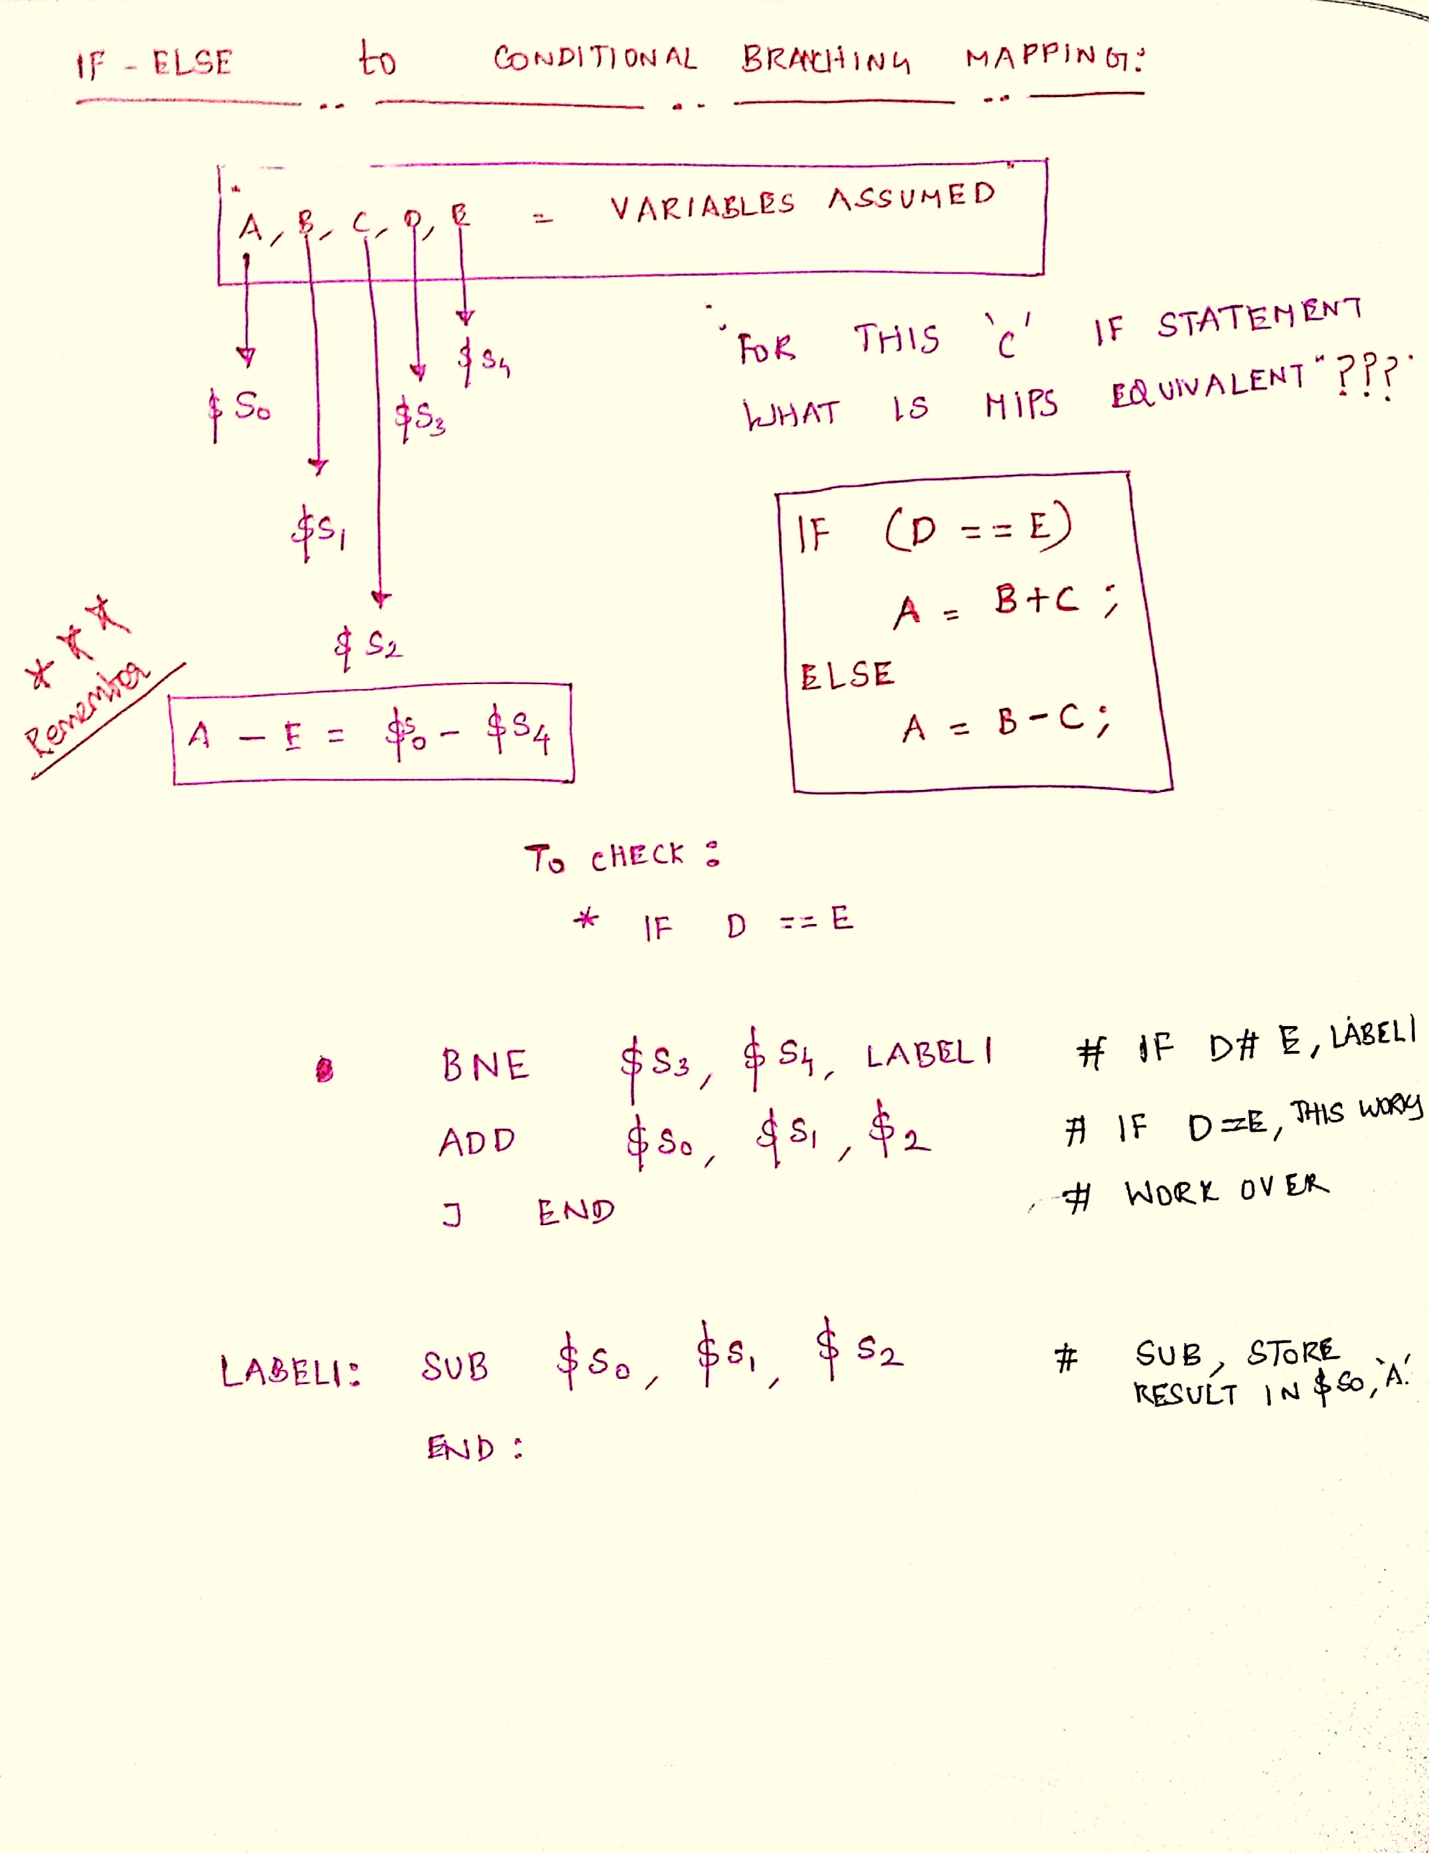
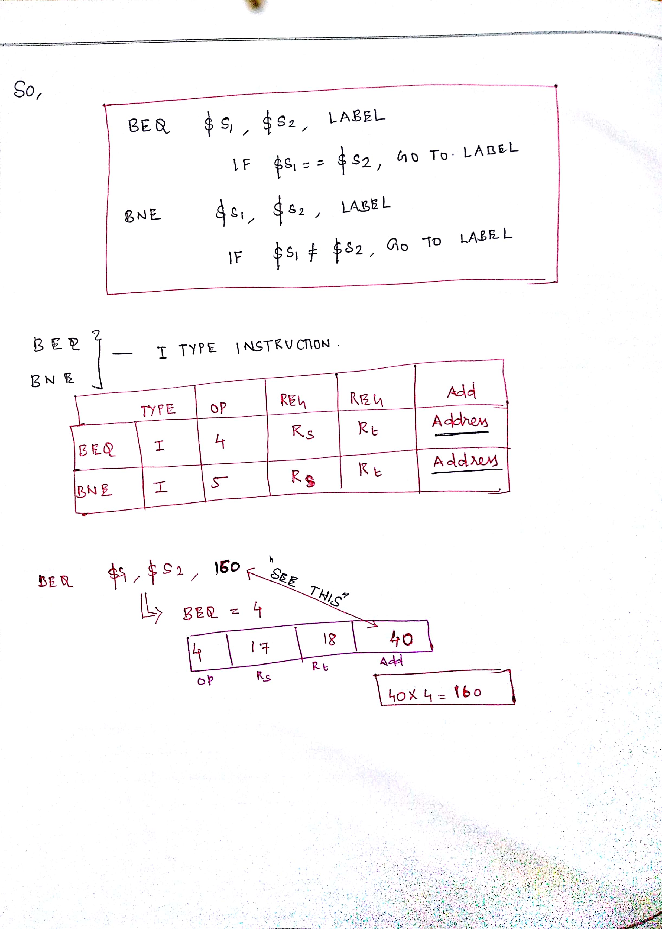
Contd.,

Slide 5
While – let’s learn it for a while.
Why important?
Iterative operations are carried out with Loops (after checking for conditions).
Recollect what do we do with traditional while loop in the C Programming.
An instance shall be handy.
Let us write code for while in MIPS with having C code as reference.

Slide 6
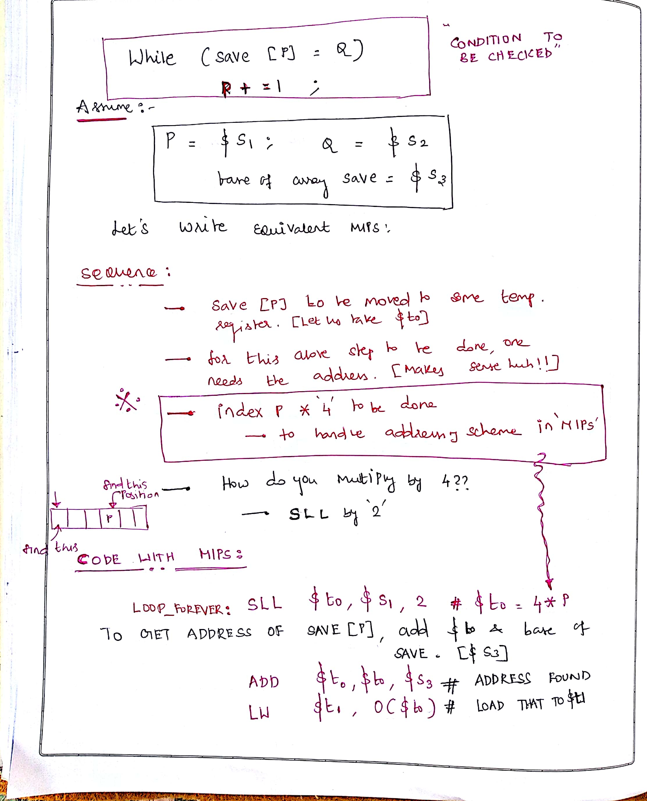
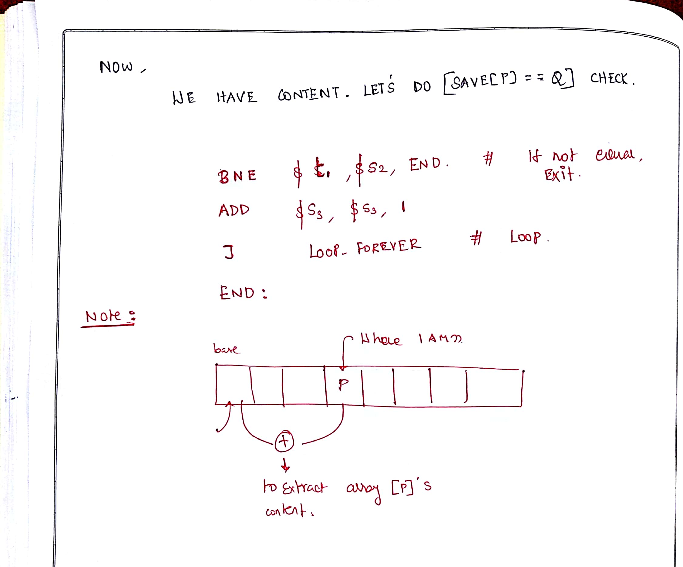

Slide 7
Let us know SWITCH - CASE
You know what is switch-case. It provides comfort for the programmer to select one of alternatives.
Many languages including scripting languages support switch-case.
We do not have switch case supported directly through instructions in MIPS.
But, we have other ideas.
Implement switch case through if-then-else sequence.
Try this out yourself! A simple home work, folks!

Slide 8
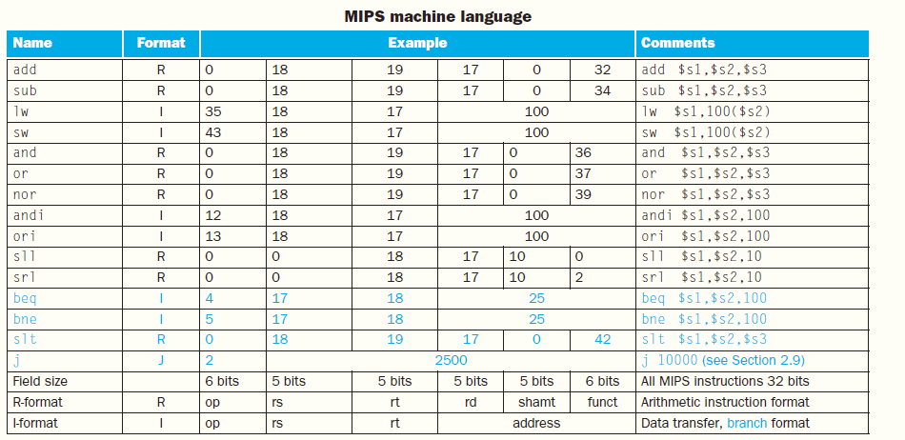
A final summary!

Slide 9
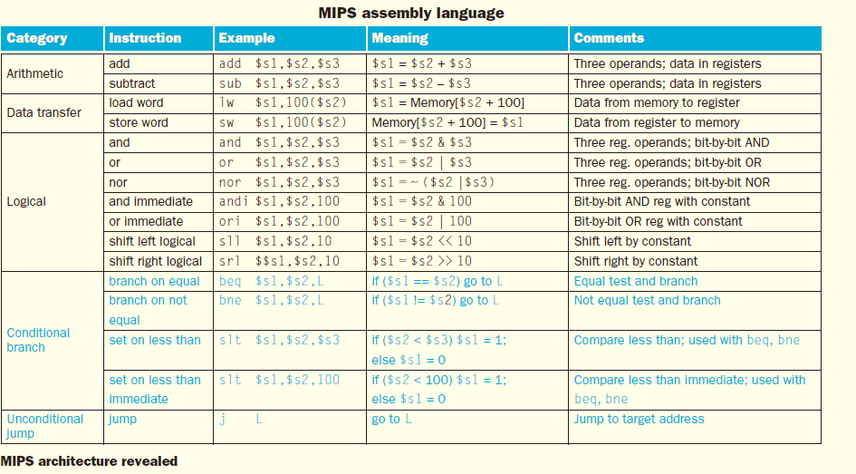
Contd.,

